Slide 1
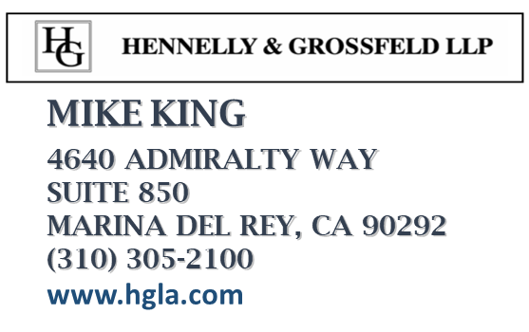


Artificial Intelligence and Liability Risks
May 19,2020
Notes:
1

Slide 2
What Is AI?
Notes:
2

Slide 3
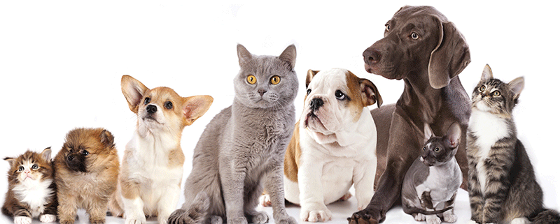
3
Notes:
How do we distinguish between dogs and cats? Easy and instantaneous. But, can you write in ascending order of importance the factors by which you distinguish? Write an algorithm distinguishing dogs and cats? Our brains contain decision-making capabilities - wisdom - genetically recorded over millennia that we draw on instantaneously and non-consciously. We think it’s child’s play. In fact, it’s very hard. And we can’t even begin to explain how we do what we do. Like Toto in the Wizard of Oz, will AI pull back the curtain on how we think? Will AI create an owner’s manual for our brains, for intelligent decision-making?
3

Slide 4
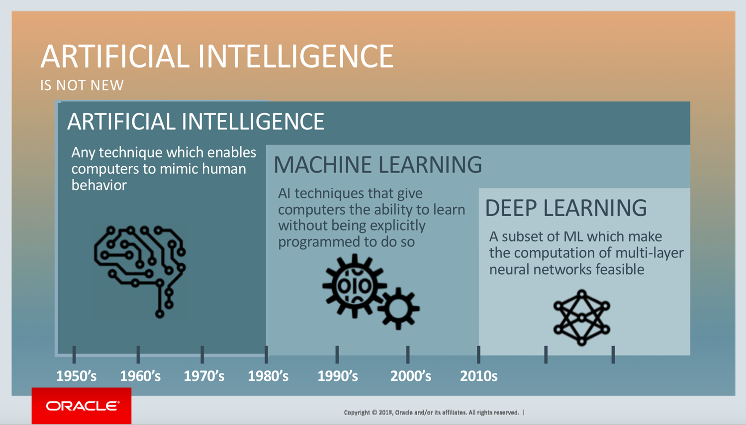
AI Today
4

Slide 5
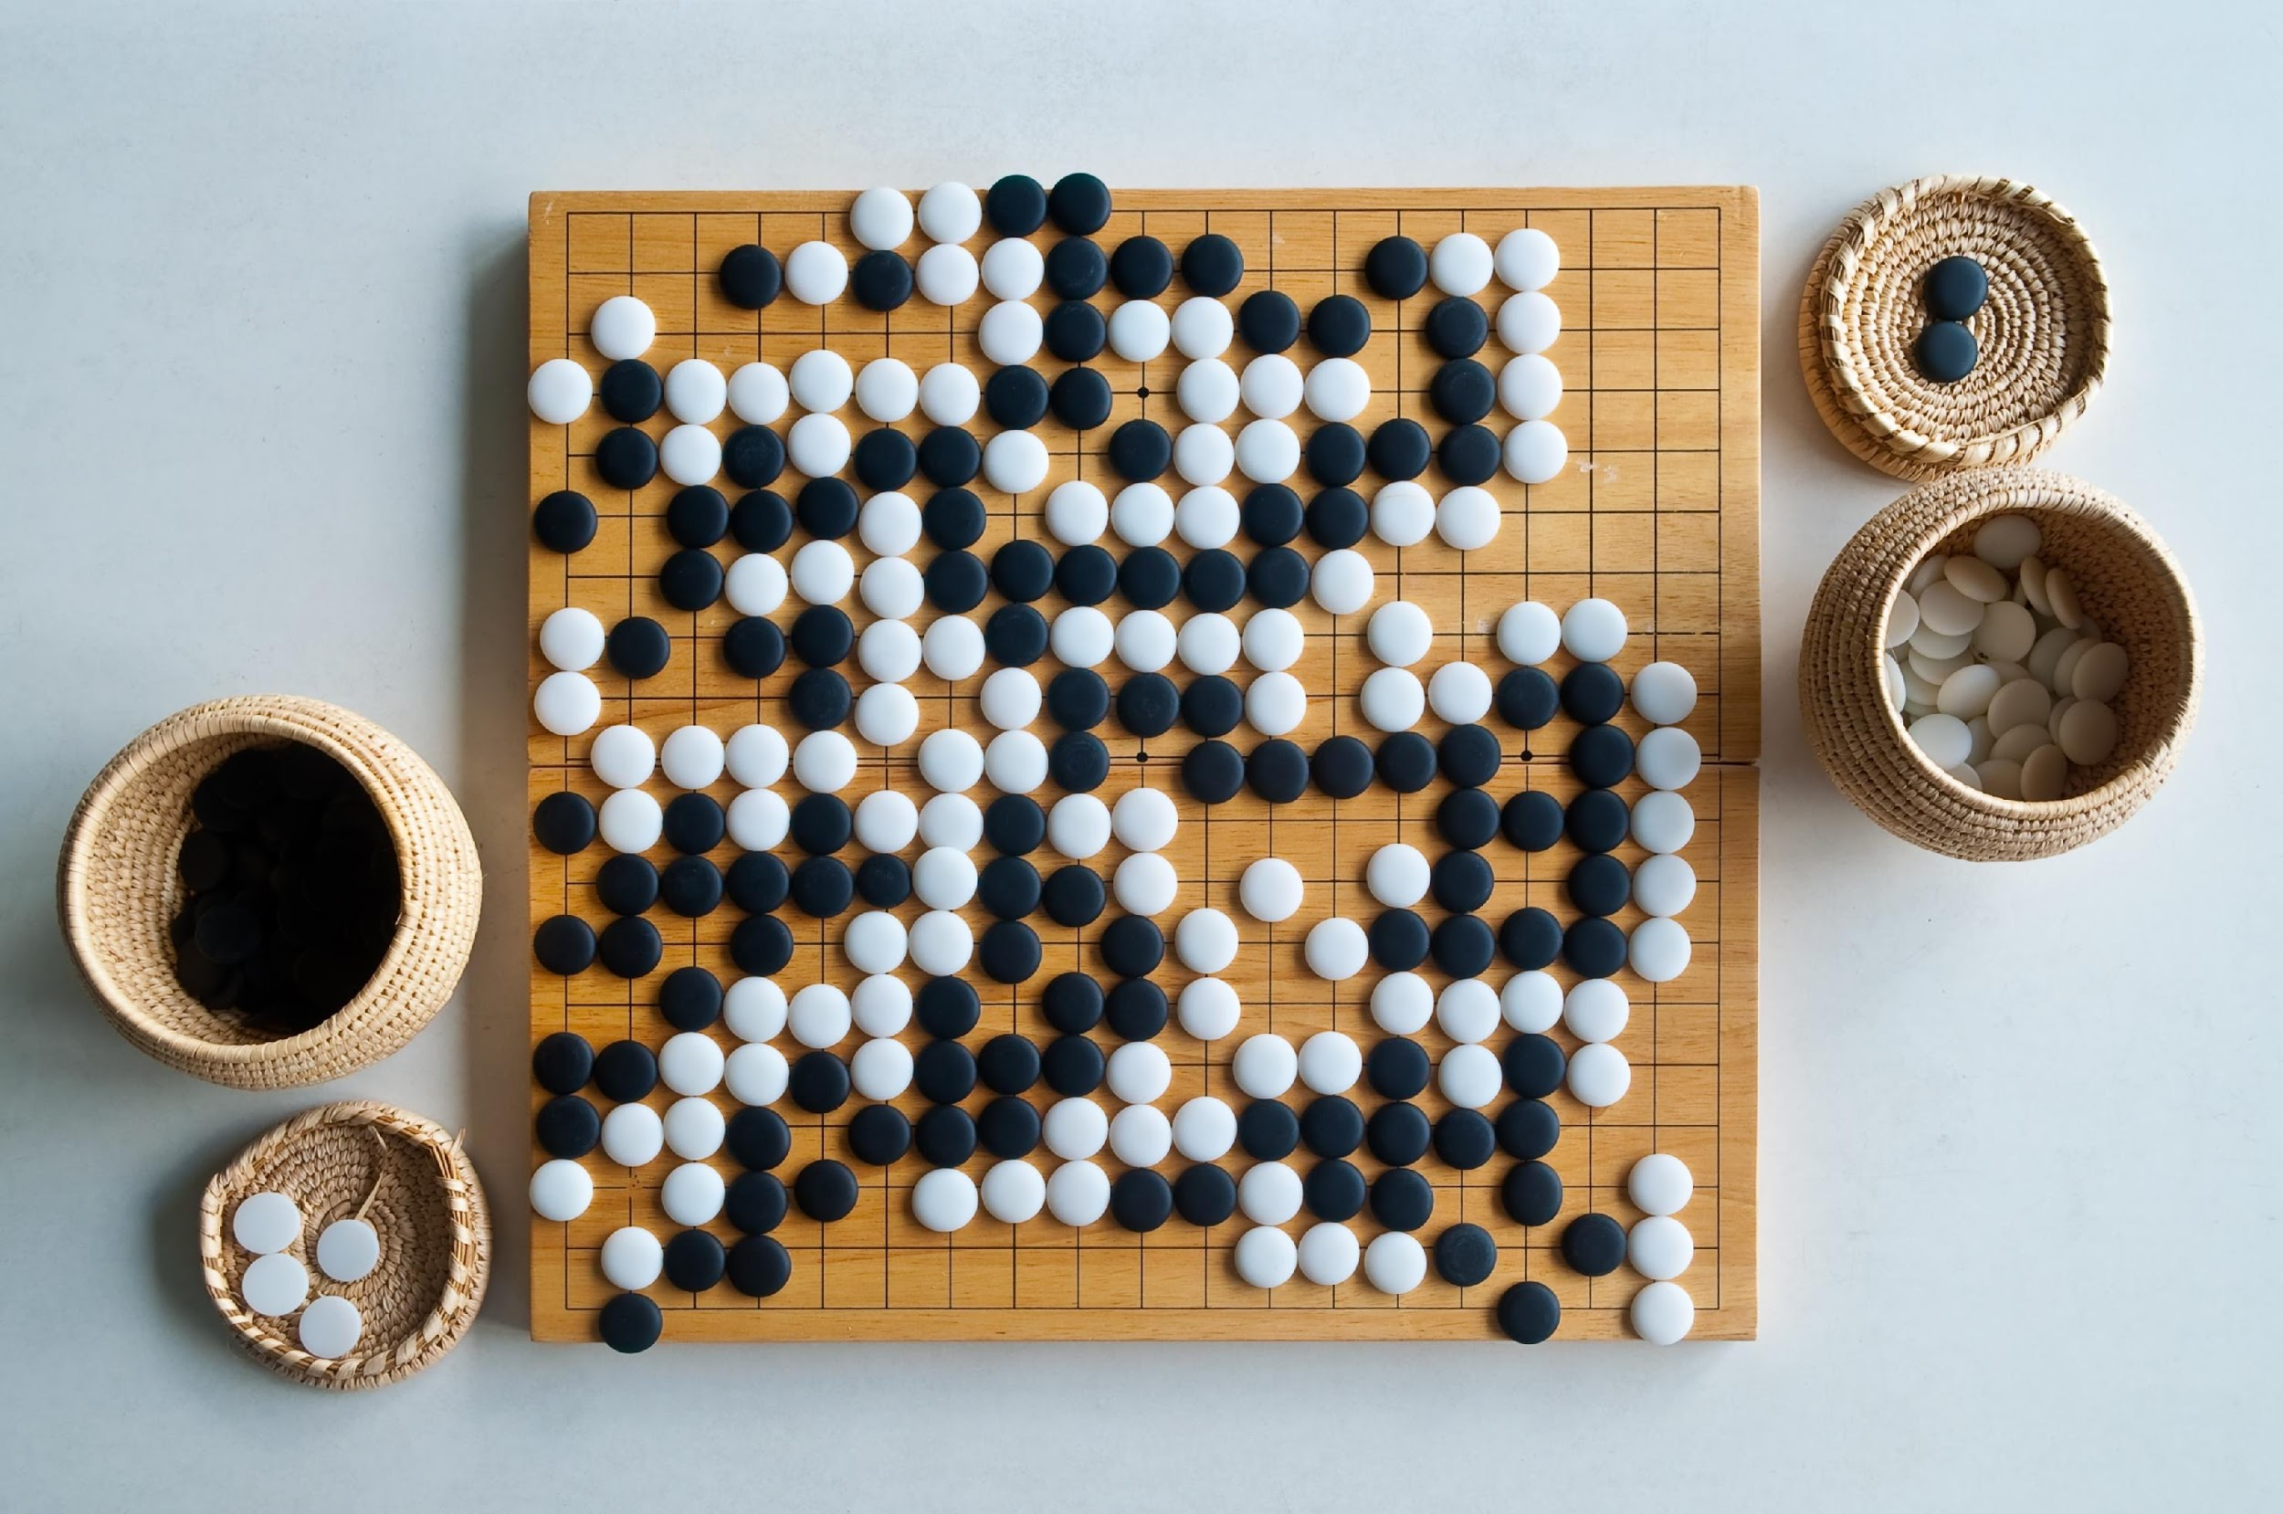
Go
5

Slide 6
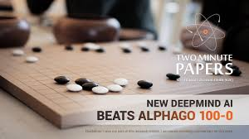
AlphaGo Zero
Zero beat AlphaGo 100-0 in 40 days
6
Notes:
In 40 days, Unsupervised machine learning beat the AI world champ. AI is beautiful and tragic. It learns to be the best in the world in a narrow application. It learns far more slowly than humans but thru sheer brute computing power speed and time becomes the best by playing millions of times. We haven’t figured out learning yet. AI is simultaneously the fastest (processing) and the slowest (learning).

Slide 7
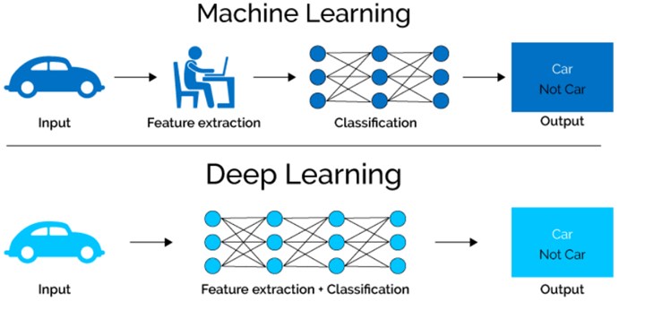
7

Slide 8
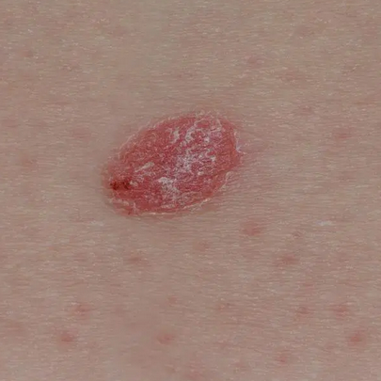
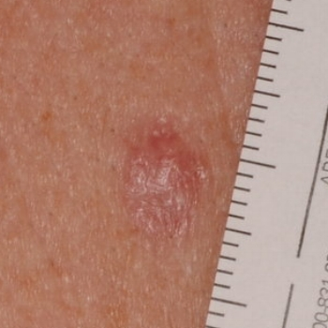
vs.
8
Notes:
AI identifies its own factors for distinguishing between benign and malignant skin cancer; but one of the factors it used was the presence of a ruler. AI has no common sense; no model of how the world works; no idea of cause and effect.

Slide 9
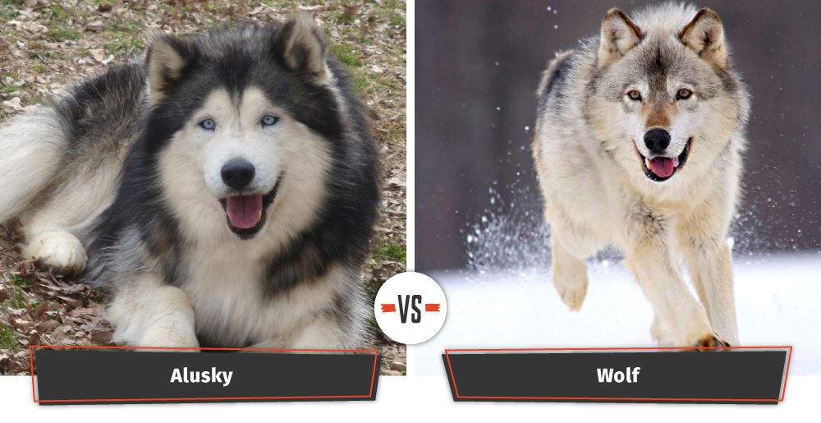
vs.
9
Notes:
Supervised machine learning on thousands or millions of labeled pictures distinguish wolves and dogs, but use “snow” to decide that it more likely is a wolf – wrong

Slide 10
AI Better At…
Computational power
Speed
Memory
Data quantity
Endurance
10

Slide 11
People Better At…
Language
General intelligence
Cause-effect
Common sense
11

Slide 12
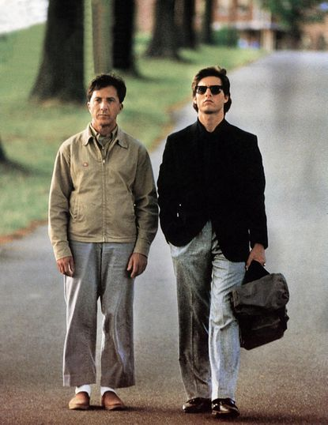
12
Notes:
AI’s super-human skills and lack of common sense make him akin to “Rain Man.” He needs his brother to watch over him.

Slide 13
What Standard
Applies to AI?
Notes:
13

Slide 14
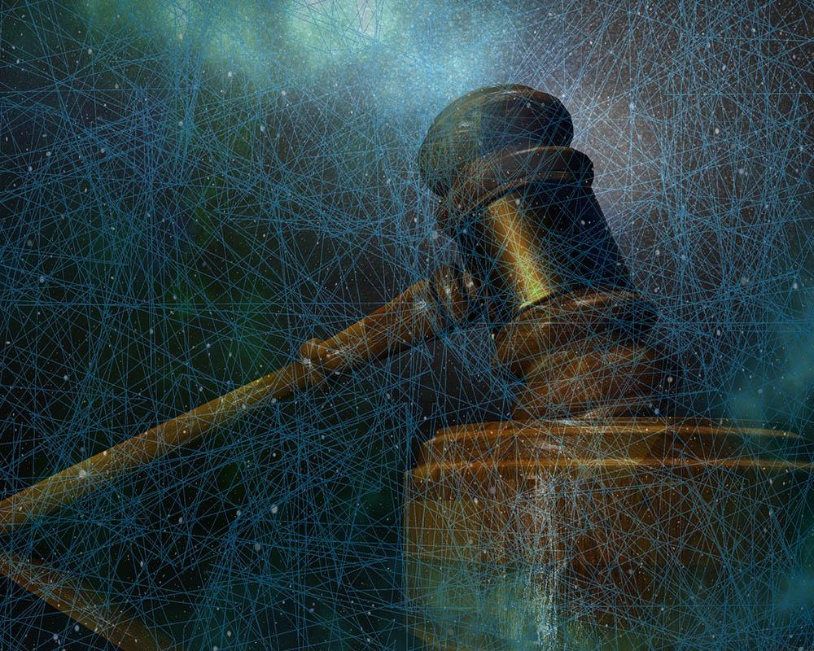
AI & Law
Bail, Sentencing & Parole
14
Notes:
AI is being used in criminal cases to make bail, sentencing, and parole decisions.

Slide 15
AI & Law
Q: COMPAS violate due process b/c proprietary nature hinders challenging scientific validity or because it takes gender into account?
A: No.
Warning required
Judge must independently determine
State of Wisconsin v. Loomis, 881 N.W.2d 749 (2016)
15
Notes:
In the Loomis case, a defendant pleaded guilty expecting the lower-end of the sentencing spectrum. The COMPAS algorithm recommended the max sentence and the judge ordered the max. The COMPAS algorithm was requested in discovery but was not disclosed under claim of trade secret. Effectively, COMPAS offered a psychologist’s expert opinion that the criminal was likely to re-offend, but refused to say why or how it reached its decision claiming it was a trade secret and thus could not be cross-examined. The Loomis court said that was okay and so was taking the defendant’s gender (male) into account in the algorithm – not a surprise since 95% of inmates are male.

Slide 16
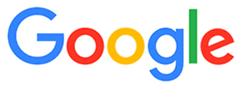
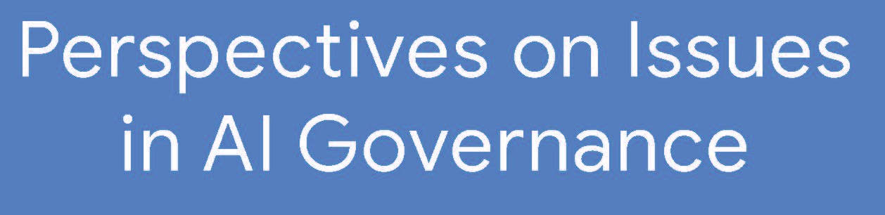
AI Liability Standard?
16

Slide 17
AI Liability Standard?
“Google recommends a cautious approach for governments with respect to liability in AI systems, since the wrong frameworks might place unfair blame, stifle innovation, or even reduce safety. Any changes to the general liability framework should come only after thorough research establishing the failure of the existing contract, tort, and other laws.”
17

Slide 18
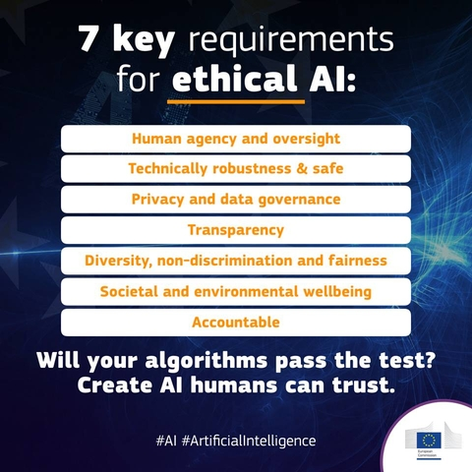
New Standards?
18
Notes:
EU has proposed 7 requirements of ethical AI. Transparency – is a new proposed standard
Unsupervised machine learning – like Alpha GO – is software that writes itself and frequently changes. How do you keep track of something that is self-generating and changing? Require transparency.

Slide 19
Explainability
If AI denies:
  Loan
  Bail/parole
  Promotion or job
Explanation?
19

Slide 20

Explainability
20

Slide 21
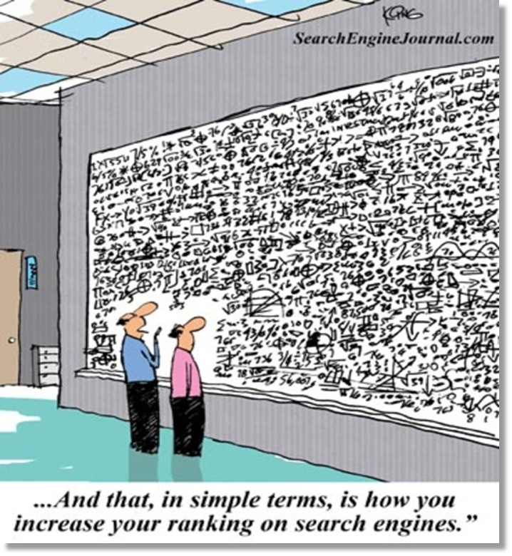
Explainability
21

Slide 22

Explainability
22

Slide 23
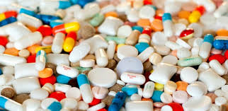
Explainability
Testing/validation – e.g., drug trials
23

Slide 24
Explain w/ Counterfactual
“If your income was $10,000/year more, then your loan would have been approved”
Explanation consistent with fair process
24

Slide 25
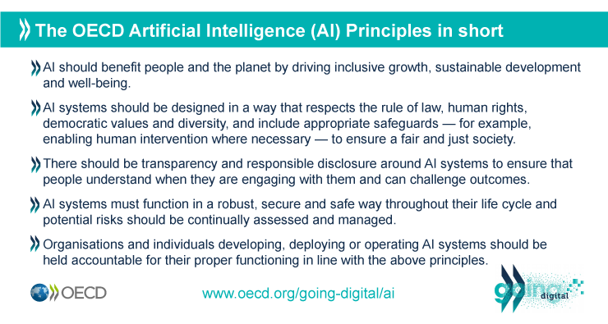
New Standards?
25
Notes:
OECD has 5 proposed principles for AI.
Bullets 3 & 4 – “Transparency,” “responsible disclosure,” and “continually assess[ing] and manag[ing]” risks are new proposed standards.

Slide 26
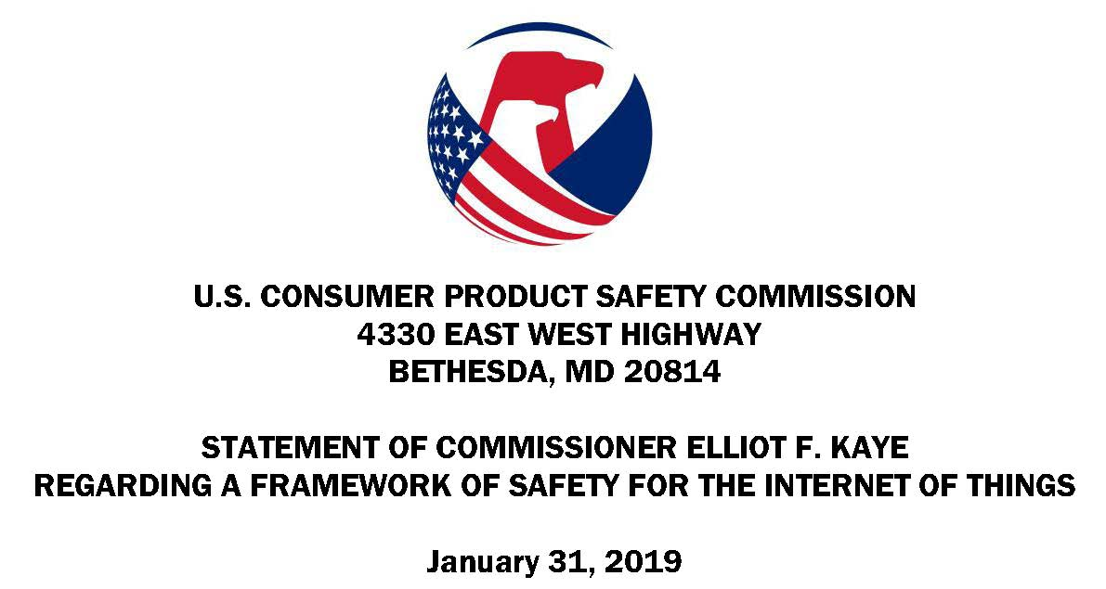
New Standards?
“Safety guidance activities and procedures should be performed during the concept phase of product development and monitored at every major milestone as the product is manufactured, placed into use, experiences defects, flaws, vulnerabilities, malfunctions and compromises that are reported to the manufacturer, corrected, modified or updated after purchase, and through end-of-life until recycled or discarded.’’
26
Notes:
CPSC Director published his personal proposal that manufacturers take actions post-sale

Slide 27
New Standards?
“Provide lifespan expectancies of products and the anticipated duration of post-distribution support that will be provided by the manufacturer. Most importantly, provide an explicit statement of the potential hazards of using a product longer than its expected lifespan. Lifespan expectancies may not be known at the time of purchase, but can be provided to owners as an update when this information becomes known.”
27

Slide 28
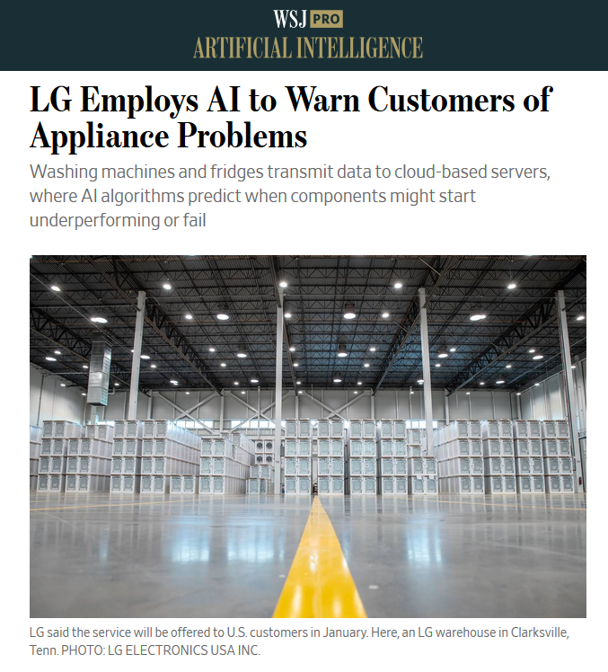
28
Notes:
AI being used to predict when machines (appliances) need maintenance
With the Internet of Things (IOT), is post-sale monitoring/patching becoming the industry standard?

Slide 29
What standard would apply
if a human was doing
what AI is?
29
Notes:
During litigation, should the same disclosure be required of AI as is required of humans?
If manager fires an employee, can he claim his reasons for doing so are trade secrets? Can AI?
If a psychologist opines that the criminal defendant is highly unlikely to commit more crime, can she say her reasons are trade secrets? Can AI? It did in the Loomis case.

Slide 30
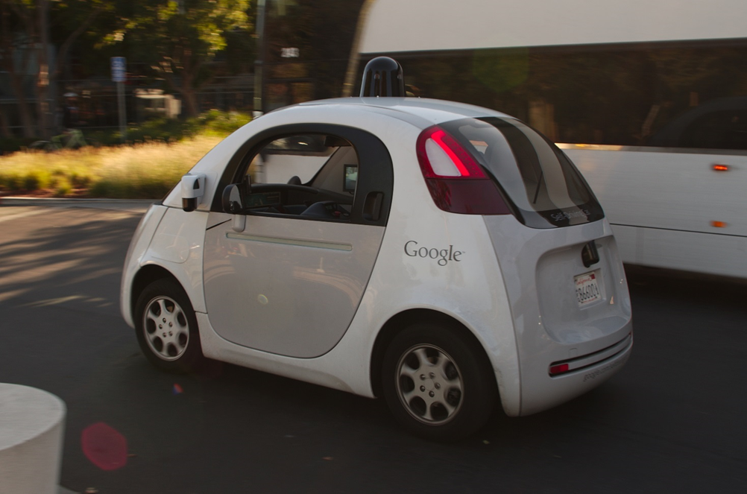
AI & Law
Difference between sensor and software causing crash?
30
Notes:
Should we impose one standard if a product (e.g., camera) breaks causing a crash (products liability) and another standard if the algorithm connected to that component fails and causes the same crash (negligence)? If the AI “driver” fails, should we use the same standard regardless of what caused it to fail? Because AI is driving – doing what human drivers do – should we use the same (negligence) standard?

Slide 31
Negligence
Reasonable AI?
Reasonable person + AI?
Different standard if AI demonstrably safer/ efficient/productive?
Shift burden?
31

Slide 32
Negligence v.
Products Liability
Hypothetical:
  Dr. – 55% correct
  AI – 90% correct
  Under negligence, likely NOT liable
  Under product liability, more likely liable
“Punish” better performance?
Hospital: Under what circumstances/ procedures allow Dr.’s “gut” to override AI?
32

Slide 33
AI & Law
State and Local Laws Touching AI
California’s BOT Act: Bot-labeling (disclosure) law
California Consumer Privacy Act (CCPA): governs privacy and data collection
SF Stop Secret Surveillance Ordinance: Ban on use of facial recognition technology by city agencies (other states are following)
IL Artificial Intelligence Video Interview Act: Informed consent obligation re the use of AI in the interview process
Patchwork of autonomous vehicle regulations in various states
33

Slide 34
AI & IP
Notes:
34

Slide 35

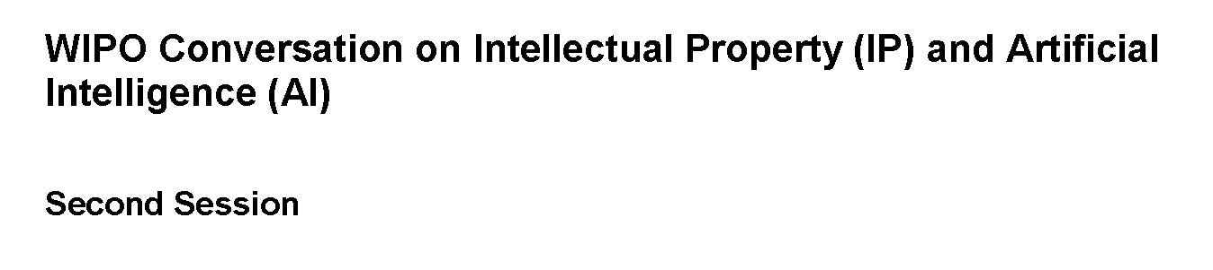
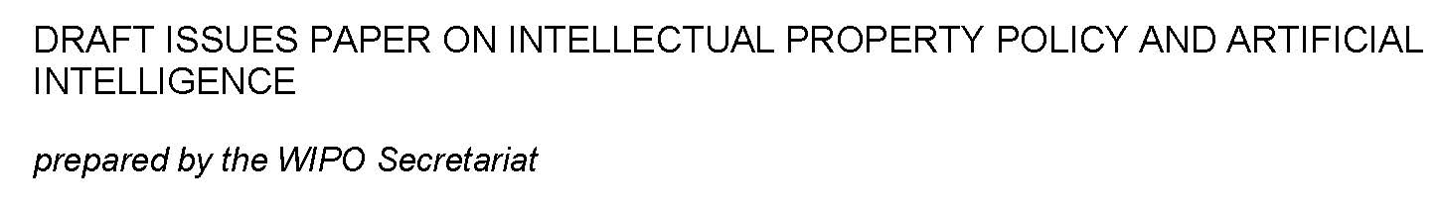
IP Liability
35
Notes:
Wide ranging topics – many countries are also grappling with these questions

Slide 36
IP Liability
AI as inventor, creator?
Infringement detectability concerns/ issues
36
Notes:
Corporate balance sheet analogy – assets and liabilities – IP’s impact on both ends
For patents and copyrights → fundamental issues of why we grant these rights, who should get them
US Patent Office, WIPO seeking comments
EPO refusal to grant patent applications on inventions made by AI (last month)
Fundamental questions - Why do have these rights? Encourage disclosure of IP, spur innovation → eventual contribution to public domain
Is a human creator or inventor essential?
Art. I, Section 8, Cl.8: The Congress shall have Power To...promote the Progress of Science and useful Arts, by securing for limited Times to Authors and Inventors the exclusive Right to their respective Writings and Discoveries....
US patent → “inventor” → “natural born person”
E.g., AI created drug now in clinical trial “AI-designed drug to enter human clinical trial for first time” Financial Times, Jan 29, 2020 (molecule for OCD treatment – AI dramatically cut down time to test chemical compounds)
Monkey selfie case (2016 Copyright case PETA filed on behalf of monkey who took photograph)

Slide 37
Regulating AI
Notes:
37

Slide 38
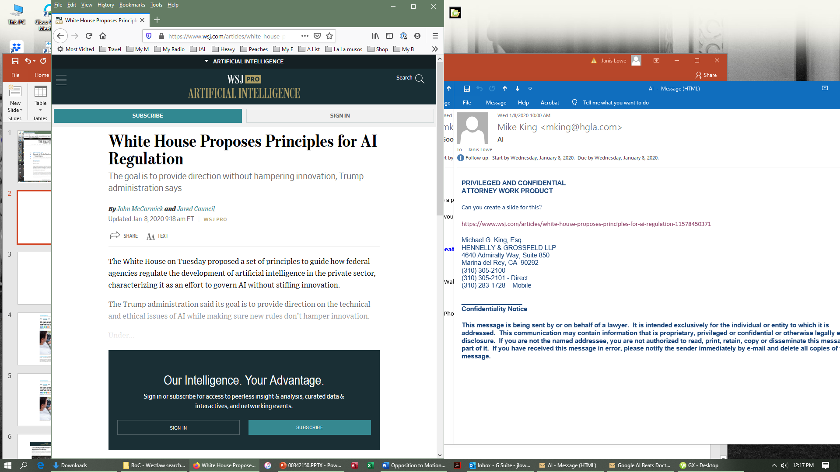
38
Notes:
Part of larger AI initiative → a lot has to do with China’s rise in AI and its perceived advantages – see papers from the Center for A New American Security
(1) promote sustained AI R&D investment, (2) unleash Federal AI resources, (3) remove barriers to AI innovation, (4) empower the American worker with AI-focused education and training opportunities, and (5) promote an international environment that is supportive of American AI innovation and its responsible use.
(1) Public trust in AI. | (2) Public participation. | (3) Scientific integrity and information quality. | (4) Risk assessment and management. | (5) Benefits and costs. | (6) Flexibility. | (7) Fairness and nondiscrimination. | (8) Disclosure and transparency. | (9) Safety and security. | (10) Interagency coordination.

Slide 39
Regulatory Requirements?
National Algorithm Safety Board?
Flight data recorder for every robot/algorithm?
Mandatory “kill switch”?
39
Notes:
See NIST (National Institute of Standards and Technology, Dept. of Commerce) study from December – landmark benchmark study on facial recognition accuracy
189 software algorithms from 99 developers
four collections of photographs containing 18.27 million images of 8.49 million people – source State Dept, FBI, Dept. Homeland Security
Metadata included age, sex, and either race or country of birth

Slide 40
Data & Bias Issues
Notes:
40

Slide 41
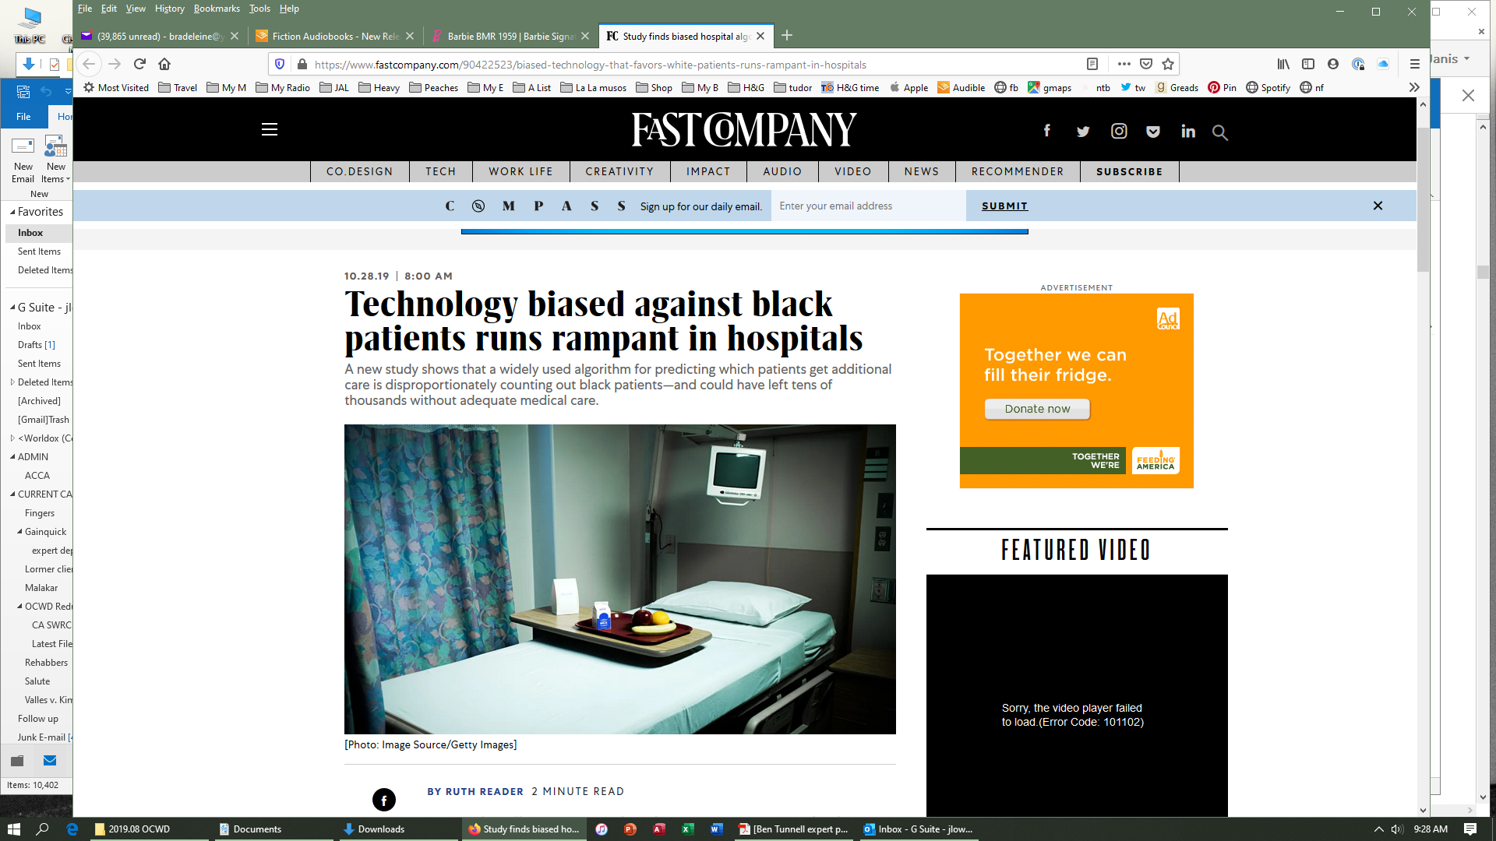
Recent Developments
41
Notes:
The bias appears to stem from how the system, which the Washington Post identifies as being made by the health services company Optum, quantifies what it means to be sick. Rather than using illness or biological data, the algorithm uses cost and insurance claim information to understand how healthy a person is. The more dollars spent, the logic goes, the sicker a person is. The data revealed that less was being spent on black patients in part because they were receiving less care.

Slide 42
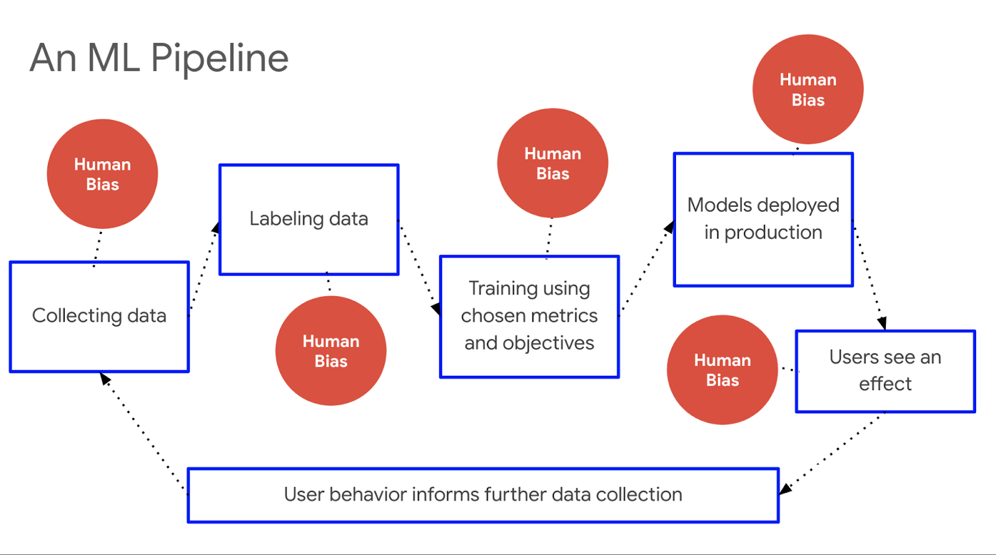
42

Slide 43
Data – “Good Data”
Data that creates software that has “seen” a lot and has the “collective experience” of 1000x humans
Collected in a real world setting (e.g., “Hey Google” – voice data collected with car, TV or babies crying in the background)
43

Slide 44
Data – “Good Data”
Collected with an intentionally inclusive acquisition strategy (e.g., spectrum of skin tones, accents, facial structures, body shapes)
Collected with safety in mind –
  Confidence levels are sufficient enough for software’s purpose (e.g., self-driving cars may require a 100% confidence score; home smart cameras may only require 65%)
  Technical and organizational controls are in place
44

Slide 45
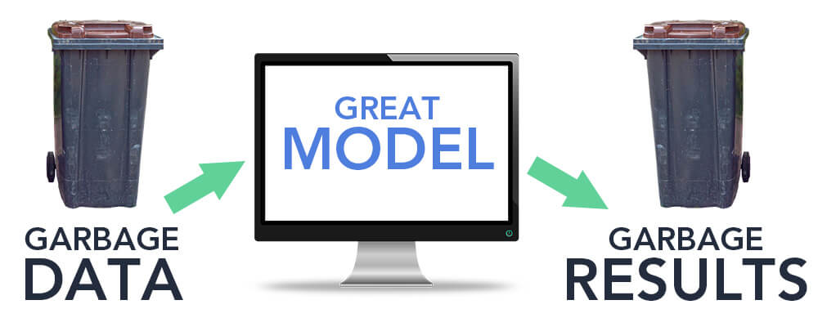
Data Issues
45
Notes:
Image recognition – not recognize Indian bride; Kidney disease data from VA – not as effective re women

Slide 46
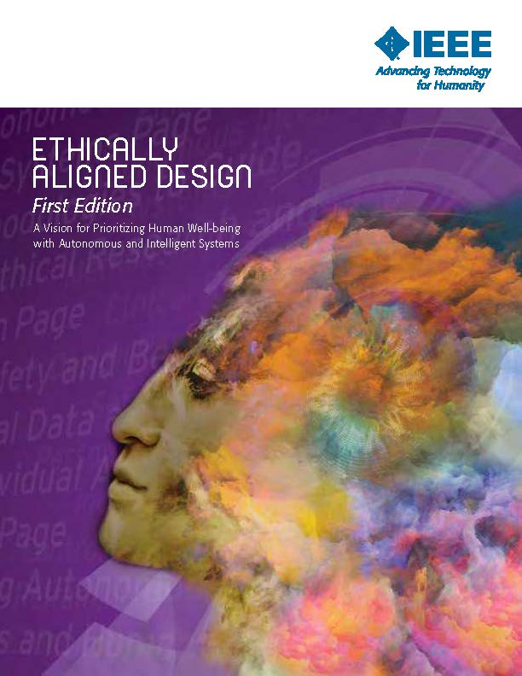
IEEE AI Ethics
Notes:
IEEE - Abbreviation of Institute of Electrical and Electronics Engineers, pronounced I-triple-E. IEEE is an organization composed of engineers, scientists, and students.

Slide 47
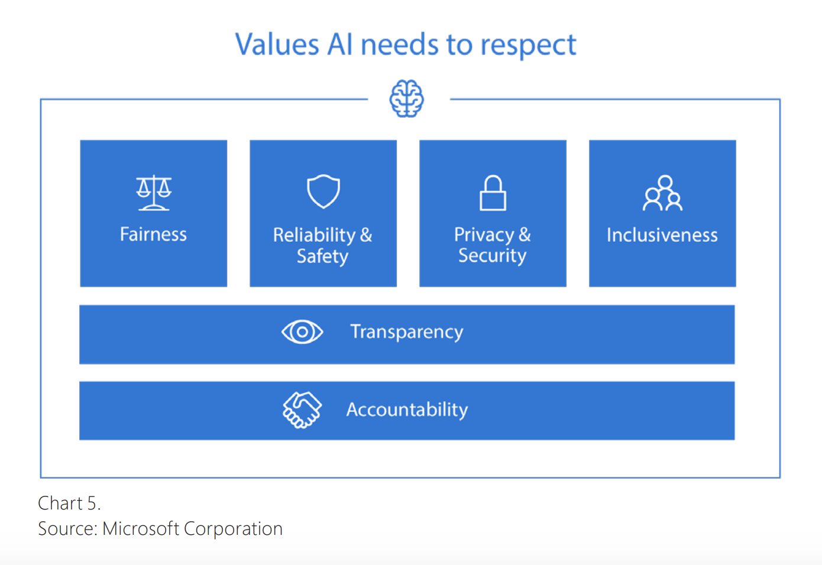
Microsoft’s AI Principles

Slide 48
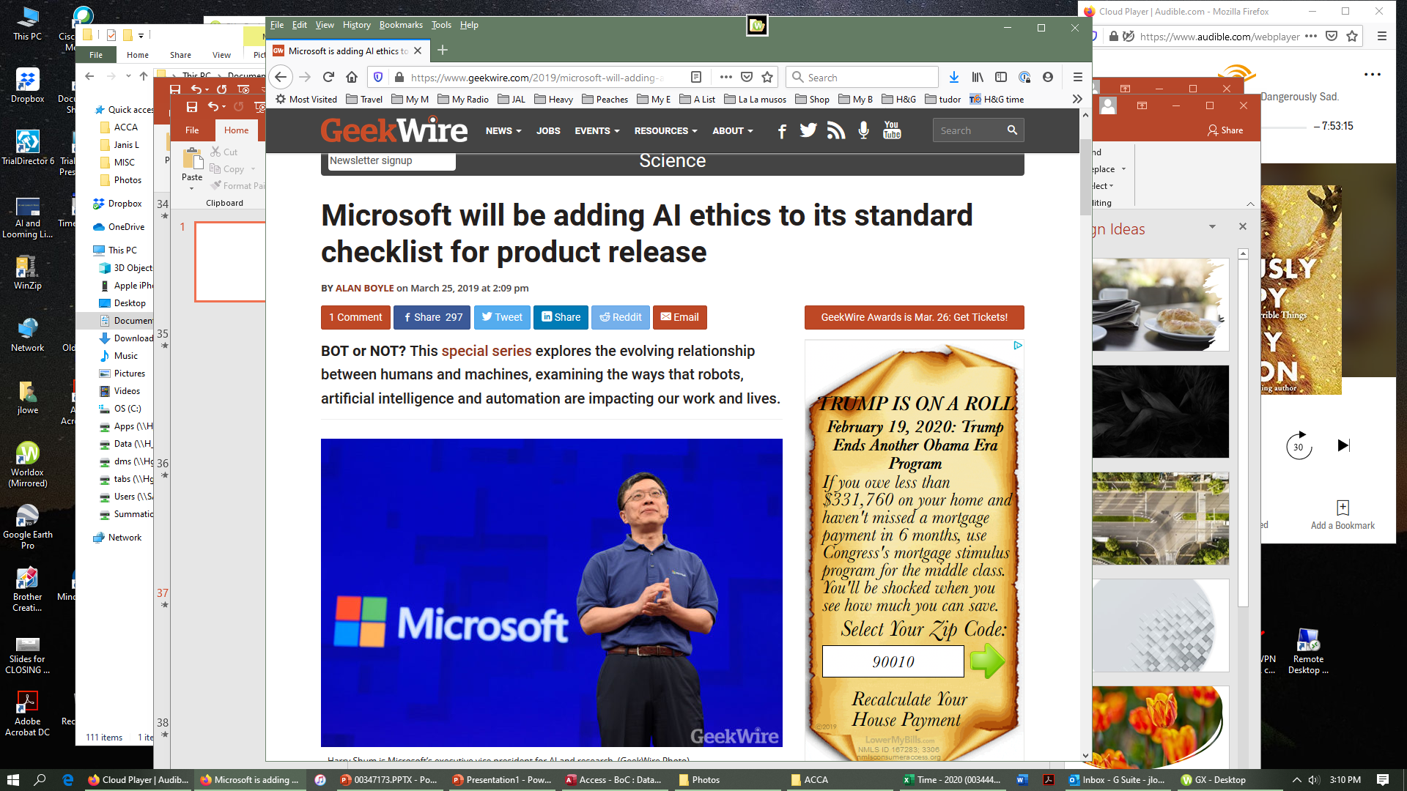
Microsoft’s AI Principles

Slide 49

49

Slide 50
Thank You!

